Slide 1
The Basic Practice of Statistics Ninth Edition David S. Moore William I. Notz
Chapters 16 and 32
Confidence Intervals:
The Basics
Lecture Slides
© 2021 W. H. Freeman and Company

Slide 2
In Chapter 16, we cover …
The reasoning of statistical estimation
Margin of error and confidence level
Confidence intervals for a population mean
How confidence intervals behave

Slide 3
In Chapter 32, we cover …
Generating bootstrap samples
Bootstrap standard errors and confidence intervals

Slide 4
Statistical inference
After we have selected a sample, we know the responses of the individuals in the sample. However, the reason for taking the sample is to infer from that data some conclusion about the wider population represented by the sample.
Statistical inference provides methods for drawing conclusions about a population from sample data.
Population
Collect data from a representative sample
Sample
Make an inference about the population

Slide 5
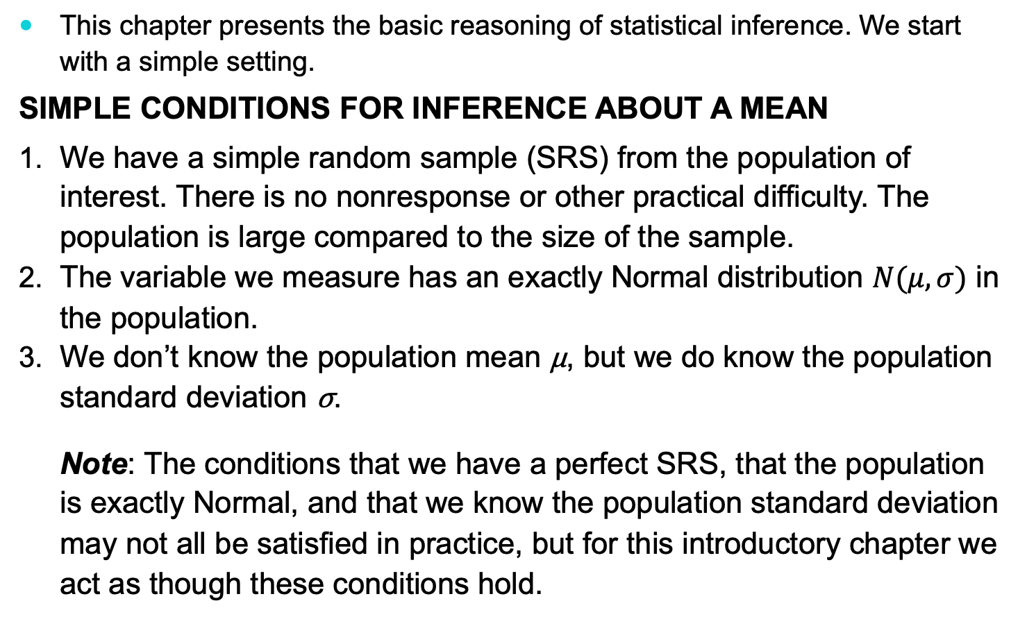
Simple conditions for inference about a mean
This chapter presents the basic reasoning of statistical inference. We start with a simple setting.
Simple Conditions for Inference About a Mean
We have a simple random sample (SRS) from the population of interest. There is no nonresponse or other practical difficulty. The population is large compared to the size of the sample.
The variable we measure has an exactly Normal distribution $N(μ, σ)$ in the population.
We don’t know the population mean μ, but we do know the population standard deviation σ.
Note: The conditions that we have a perfect SRS, that the population is exactly Normal, and that we know the population standard deviation may not all be satisfied in practice, but for this introductory chapter we act as though these conditions hold.

Slide 6
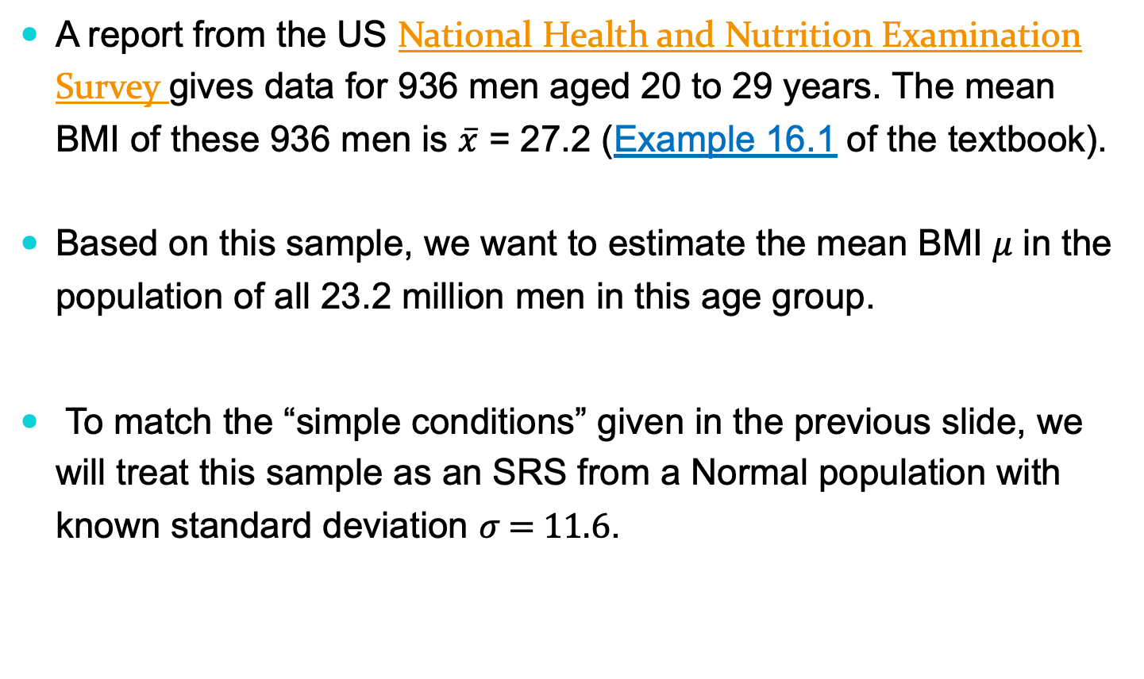
The reasoning of statistical estimation (part I)
A report from the US National Health and Nutrition Examination Survey gives data for 936 men aged 20 to 29 years. The mean BMI of these 936 men is $\overline{x}$ = 27.2 (Example 16.1 of the textbook).
Based on this sample, we want to estimate the mean BMI 𝜇 in the population of all 23.2 million men in this age group.
To match the “simple conditions” given in the previous slide, we will treat this sample as an SRS from a Normal population with known standard deviation 𝜎 = 11.6.

Slide 7
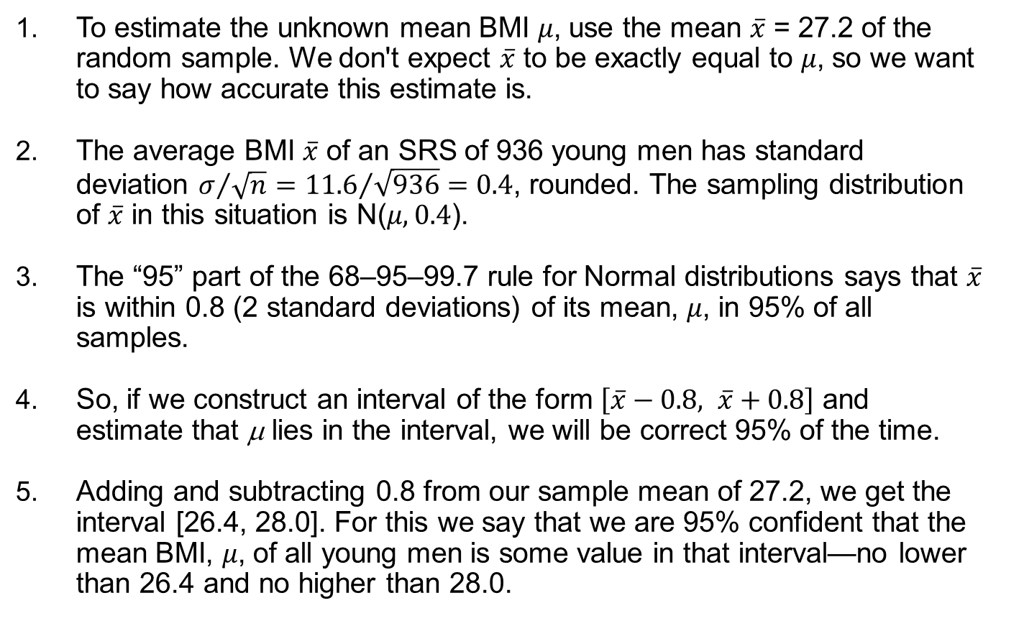
The reasoning of statistical estimation (part II)
To estimate the unknown mean BMI 𝜇, use the mean $\overline{x}$ = 27.2 of the random sample. We don't expect $\overline{x}$ to be exactly equal to 𝜇, so we want to say how accurate this estimate is.
The average BMI $\overline{x}$ of an SRS of 936 young men has standard deviation $σ/{\sqrt{n}}={11.6}/{\sqrt{936}=0.4}$, rounded. The sampling distribution of $\overline{x}$ in this situation is N(𝜇, 0.4).
The “95” part of the 68–95–99.7 rule for Normal distributions says that $\overline{x}$ is within 0.8 (2 standard deviations) of its mean, 𝜇, in 95% of all samples.
So, if we construct an interval of the form $\left[\overline{x}−0.8, \overline{x}+0.8\right]$ and estimate that μ lies in the interval, we will be correct 95% of the time.
Adding and subtracting 0.8 from our sample mean of 27.2, we get the interval [26.4, 28.0]. For this we say that we are 95% confident that the mean BMI, 𝜇, of all young men is some value in that interval—no lower than 26.4 and no higher than 28.0.

Slide 8
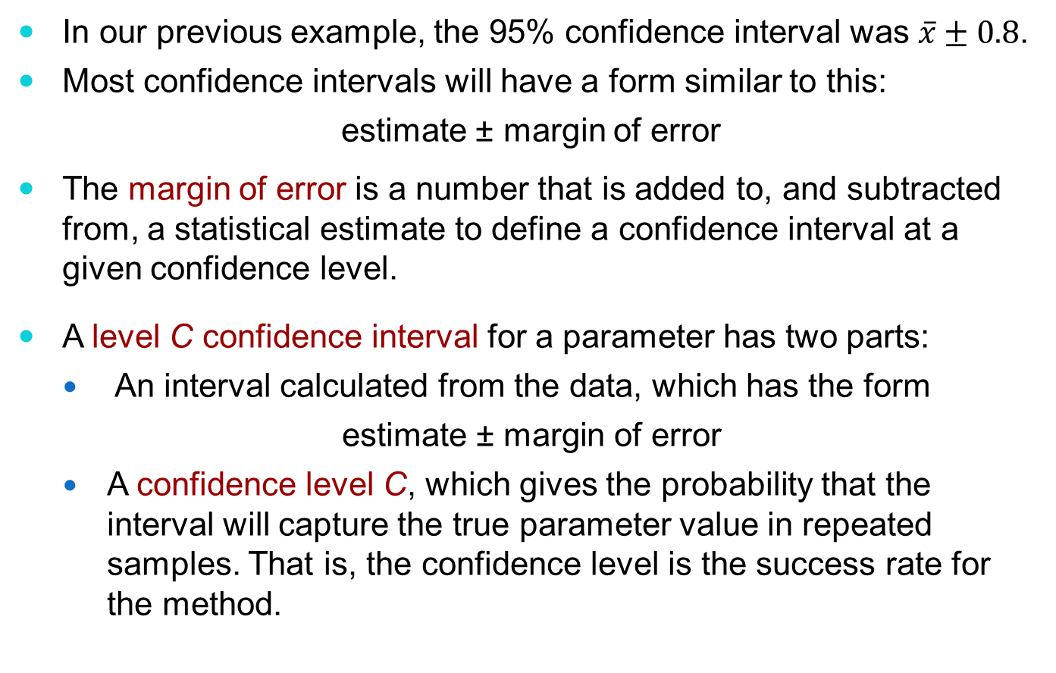
Confidence interval
In our previous example, the 95% confidence interval was $\overline{x}±0.8$.
Most confidence intervals will have a form similar to this:
estimate ± margin of error
The margin of error is a number that is added to, and subtracted from, a statistical estimate to define a confidence interval at a given confidence level.
A level C confidence interval for a parameter has two parts:
An interval calculated from the data, which has the form
$$\text{estimate}\text{ ± }\text{margin} \text{of} \text{error}$$
A confidence level C, which gives the probability that the interval will capture the true parameter value in repeated samples. That is, the confidence level is the success rate for the method.

Slide 9
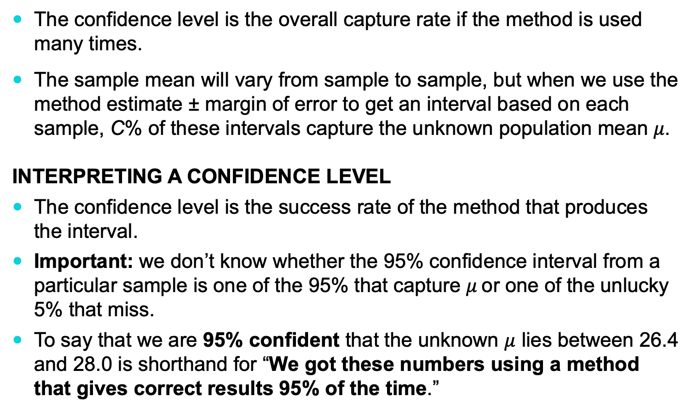
Confidence level
The confidence level is the overall capture rate if the method is used many times.
The sample mean will vary from sample to sample, but when we use the method estimate ± margin of error to get an interval based on each sample, C% of these intervals capture the unknown population mean 𝜇.
INTERPRETING A CONFIDENCE LEVEL
The confidence level is the success rate of the method that produces the interval.
Important: we don’t know whether the 95% confidence interval from a particular sample is one of the 95% that capture 𝜇 or one of the unlucky 5% that miss.
To say that we are 95% confident that the unknown $μ$ lies between 26.4 and 28.0 is shorthand for “We got these numbers using a method that gives correct results 95% of the time.”

Slide 10
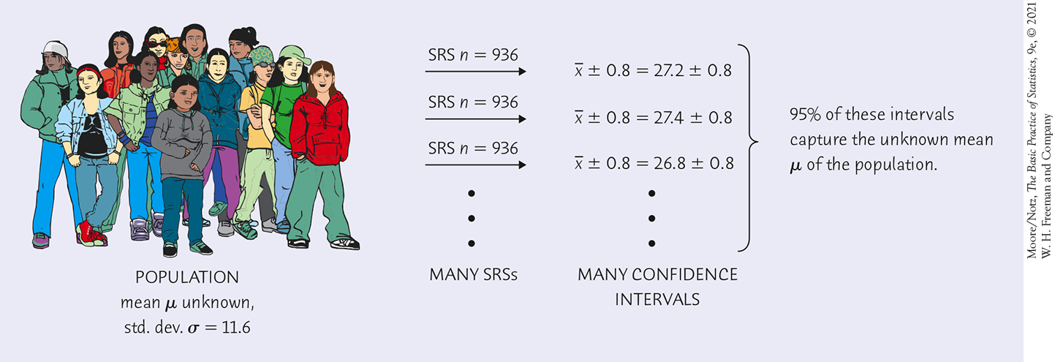
Confidence level illustrated (part I)

Slide 11
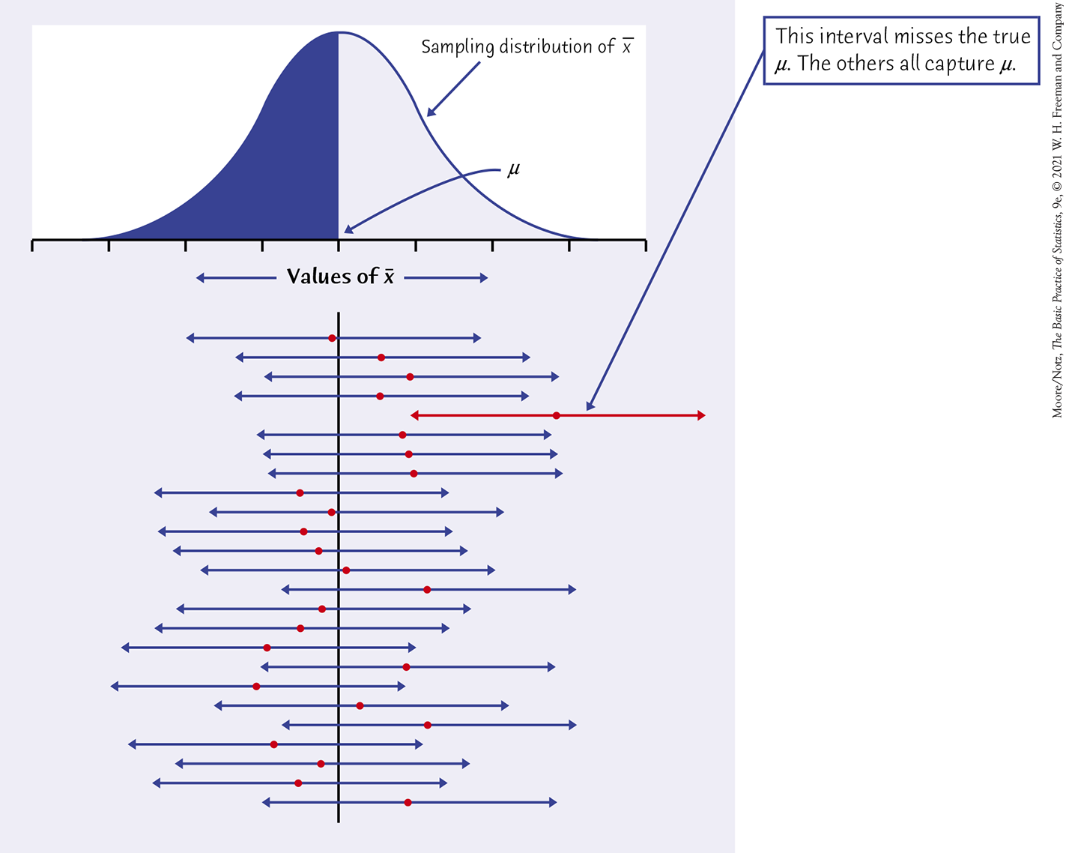
Confidence level illustrated (part II)

Slide 12
Confidence intervals for a population mean (part I)
In Example 16.1, wanting “95% confidence” dictated going out 2 standard deviations in both directions from the mean—if we change our confidence level C, we will change the number of standard deviations.
Once we have these, we may build any level C confidence interval we wish.
CONFIDENCE INTERVAL FOR THE MEAN OF A NORMAL POPULATION
Draw an SRS of size n from a Normal population having unknown mean 𝜇 and known standard deviation 𝜎. A level C confidence interval for 𝜇 is
From the Standard Normal table of cumulative proportions
Confidence level C | 90% | 95% | 99%
Critical value z* | 1.645 | 1.960 | 2.576
Some examples of critical values, z*, corresponding to the confidence level C are given above.

Slide 13
Confidence intervals: the four-step process
The steps in finding a confidence interval mirror the overall four-step process for organizing statistical problems.
The Four-Step Process
State: What is the practical question that requires estimating a parameter?
Plan: Identify the parameter, choose a level of confidence, and select the type of confidence interval that fits your situation.
Solve: Carry out the work in two phases:
1. Check the conditions for the interval that you plan to use.
2. Calculate the confidence interval.
Conclude: Return to the practical question to describe your results in this setting.

Slide 14
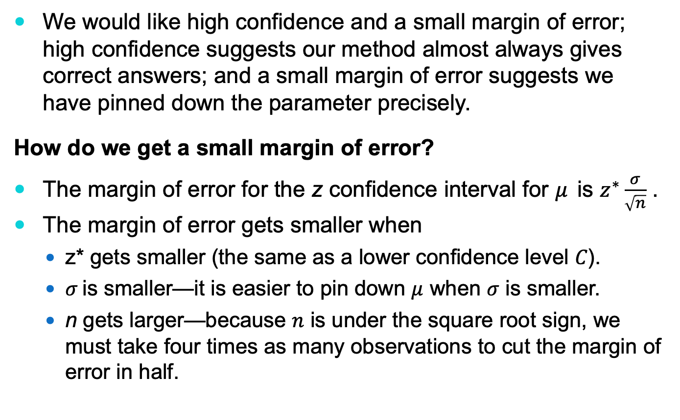
How confidence intervals behave
We would like high confidence and a small margin of error; high confidence suggests our method almost always gives correct answers; and a small margin of error suggests we have pinned down the parameter precisely.
How do we get a small margin of error?
The margin of error for the z confidence interval for 𝜇 is $z^{∗}\frac{σ}{\sqrt{n}}$ .
The margin of error gets smaller when
z* gets smaller (the same as a lower confidence level 𝐶).
𝜎 is smaller—it is easier to pin down $μ$ when 𝜎 is smaller.
n gets larger—because 𝑛 is under the square root sign, we must take four times as many observations to cut the margin of error in half.

Slide 15
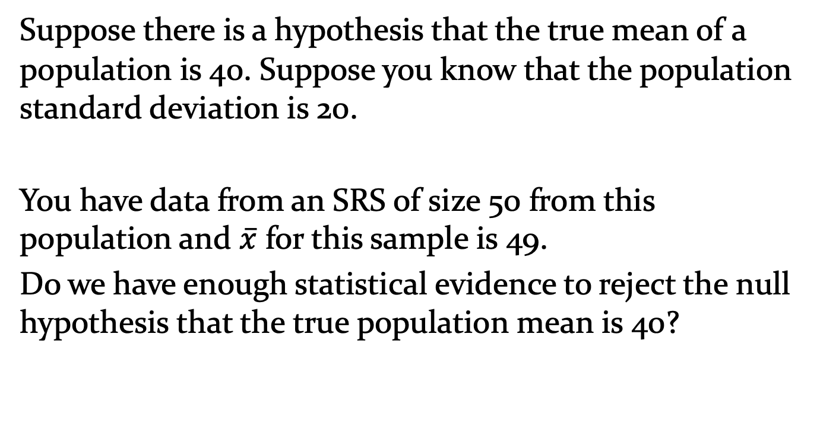
Example from Ch. 12 – statistical significance
Suppose there is a hypothesis that the true mean of a population is 40. Suppose you know that the population standard deviation is 20.
You have data from an SRS of size 50 from this population and $\overline{x}$ for this sample is 49.
Do we have enough statistical evidence to reject the null hypothesis that the true population mean is 40?

Slide 16
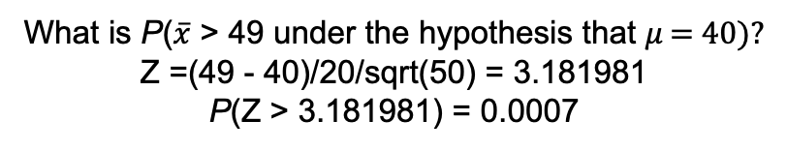
Example – statistical significance
Mean sampling distribution under the hypothesis that the true population mean is 40 → Normal(40, 20/sqrt(50))
We know this, not part of the hypothesis
An observed sample mean of 49 seems to be unusual if the hypothesis was true.
What is P($\overline{x}$ > 49 under the hypothesis that 𝜇 = 40)?
Z =(49 - 40)/20/sqrt(50) = 3.181981
P(Z > 3.181981) = 0.0007
→ We do have enough evidence to reject the hypothesis that the population mean, 𝜇, is 40. In other words, the observed difference in means is statistically significant.

Slide 17
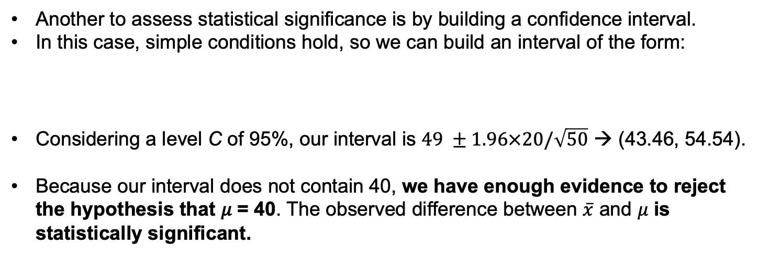
Example – statistical significance
Another to assess statistical significance is by building a confidence interval.
In this case, simple conditions hold, so we can build an interval of the form:
Considering a level C of 95%, our interval is $49 ±1.96×20/\sqrt{50}$ → (43.46, 54.54).
Because our interval does not contain 40, we have enough evidence to reject the hypothesis that 𝜇 = 40. The observed difference between $\overline{x}$ and 𝜇 is statistically significant.

Slide 18
In Chapter 32, we cover …
Generating bootstrap samples
Bootstrap standard errors and confidence intervals

Slide 19
Introduction
Sampling distributions provide an important tool for statistical inference.
Inferences based on our random sample being from a Normal population are useful in practice, but we cannot use these methods for data that are strongly skewed unless the samples are large and have no strong outliers.
Resampling is a technique in which we use the individual observations in a sample to construct the relevant sampling distribution for inference.
The construction of these sampling distributions is specific to the observed sample data.
Bootstrap is a type of resampling. With bootstrap, we can make inferences about the population from which the data are a random sample; these methods enable us to make inferences about parameters other than means.

Slide 20
Generating bootstrap samples
The bootstrap method provides a way to approximate sampling distributions using the information in the original samples.
This is done by generating many samples by sampling with replacement from the original sample.
These samples with replacement are called bootstrap samples.
Sampling with Replacement
To sample with replacement from a population, after an observation is selected, return it to the population before the next observation is drawn. Thus, the same observation can be selected multiple times when a random sample is taken with replacement.
When using software, you often have the option of selecting a sample either with or without replacement.

Slide 21
The bootstrap method
The bootstrap distribution of a statistic computed from these bootstrap samples should give an approximation to the sampling distribution of this statistic.
bootstrap Method
The bootstrap method involves creating many bootstrap samples and, for each bootstrap sample, computing the statistic of interest.
The distribution of this statistic from the bootstrap samples is known as the bootstrap distribution, and it provides an approximation to the sampling distribution of the statistic.

Slide 22
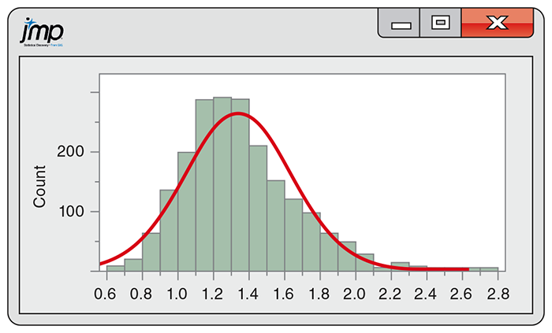
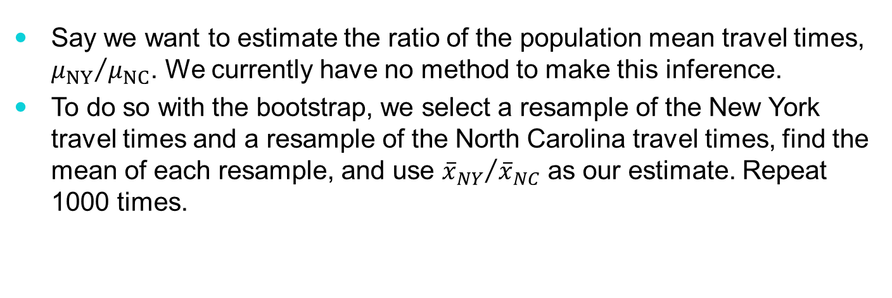
The bootstrap method—example
Here are stemplots of the New York and North Carolina travel times from Chapter 2:
Say we want to estimate the ratio of the population mean travel times, ${μ_{NY}}/{μ_{NC}}$. We currently have no method to make this inference.
To do so with the bootstrap, we select a resample of the New York travel times and a resample of the North Carolina travel times, find the mean of each resample, and use ${{\overline{x}}_{NY}}/{{\overline{x}}_{NC}}$ as our estimate. Repeat 1000 times.
Here is the histogram of the 1000 bootstrap estimates of the ratio of the means:

Slide 23
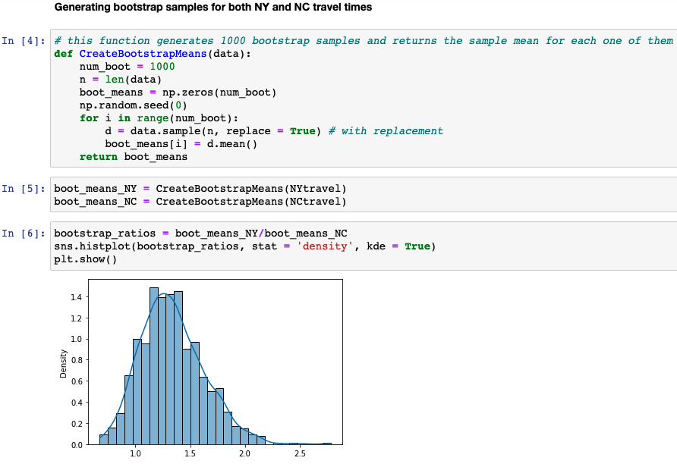
The bootstrap method – example in Python

Slide 24
Bootstrap standard errors and confidence intervals
The variability in the bootstrap distribution reflects how the statistic of interest varies from sample to sample.
A numerical measure of this variability is the standard deviation of the bootstrap distribution known as the bootstrap standard error.
Bootstrap Percentile Confidence Interval
For a 95% bootstrap confidence interval, use the lower 2.5 percentile and the upper 97.5th percentile of the bootstrap distribution as the endpoints of the confidence interval. For a 90% confidence interval, use the lower 5th percentile and the upper 95th percentile.

Slide 25
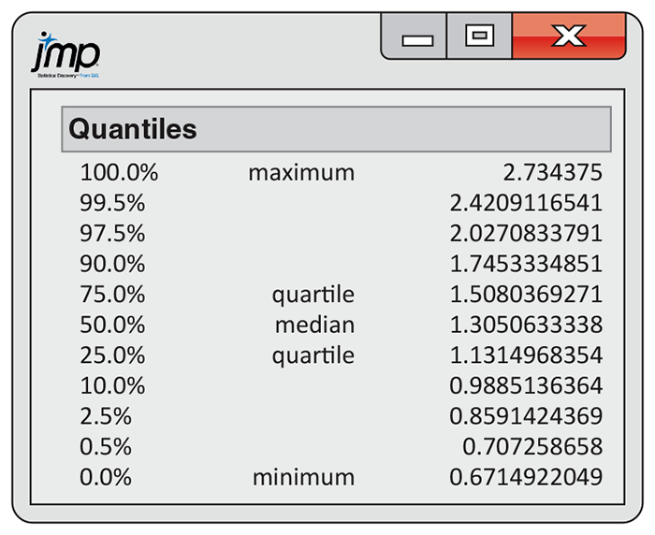
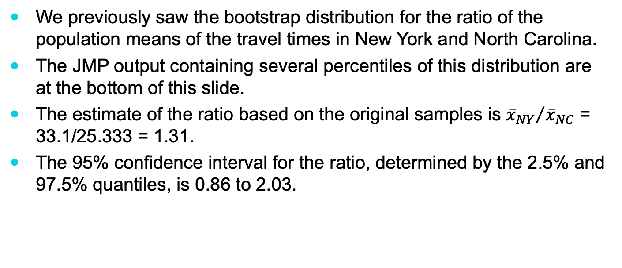
Bootstrap confidence interval—example
We previously saw the bootstrap distribution for the ratio of the population means of the travel times in New York and North Carolina.
The JMP output containing several percentiles of this distribution are at the bottom of this slide.
The estimate of the ratio based on the original samples is ${{\overline{x}}_{NY}}/{{\overline{x}}_{NC}}$ = 33.1/25.333 = 1.31.
The 95% confidence interval for the ratio, determined by the 2.5% and 97.5% quantiles, is 0.86 to 2.03.

Slide 26
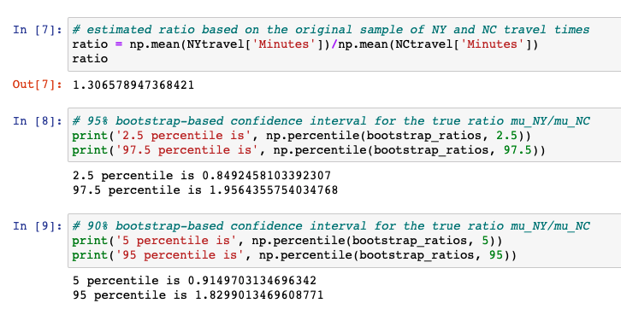
Bootstrap confidence interval - example in Python

Slide 27
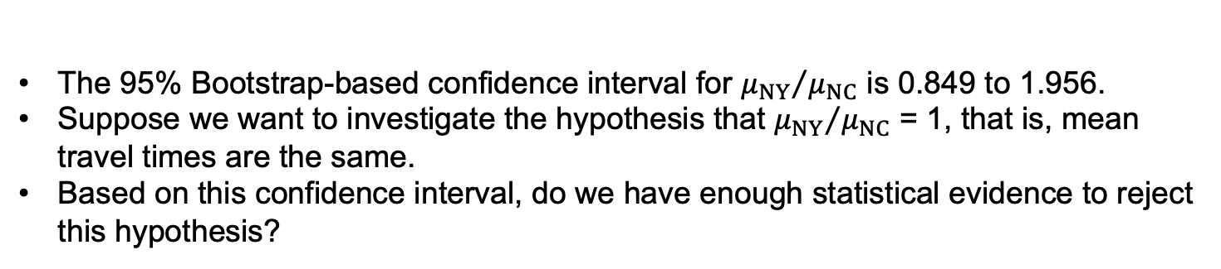
Bootstrap confidence interval - example in Python
The 95% Bootstrap-based confidence interval for ${μ_{NY}}/{μ_{NC}}$ is 0.849 to 1.956.
Suppose we want to investigate the hypothesis that ${μ_{NY}}/{μ_{NC}}$ = 1, that is, mean travel times are the same.
Based on this confidence interval, do we have enough statistical evidence to reject this hypothesis?

